Slide 1
QR PAYMENT
METHOD

Slide 2
01
05
02
USER-FRIENDLY
FASTER SERVICE
ACCESSIBILITY
THE BENEFITS OF IMPLEMENTING QR CODES FOR PAYMENTS
03
04
EFFICIENCY FOR BUSINESSES
SECURE

Slide 3
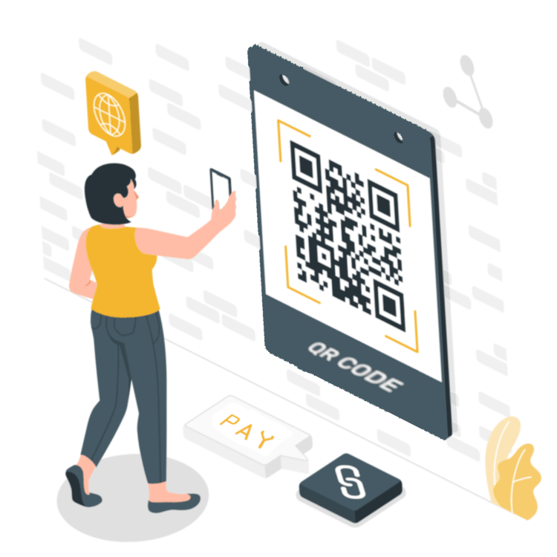
USE CASES FOR QR PAYMENTS
Here are the cases where this payment method
can do the job:
Stationary store
Online store
Restaurant
Paying for bills
Transfers between users
Purchases from vending machines
Cash withdrawal at an ATM
Travel and transportation – fuel

Slide 4
2.2 billion
This is the number of users who, according to research conducted by Juniper, will use QR payments in 2025. This is equivalent to 29% of all phone users

Slide 5

OUR BUSINESS SOLUTION
PAY AS YOU GO

Slide 6
01
03
04
HOW TO ATTRACT CLIENTS?
INTEGRATION WITH EXTERNAL SYSTEMS
CLIENT DATA USAGE
PROBLEMS TO SOLVE
02
SECURITY OF APLICATION

Slide 7
TRANSACTION FLOW
INITIAL
PENDING
ACCEPT/REJECT/TIMEOUT
User scans code
User chooses to accept/reject payment
The transaction is being processed

Slide 8
TYPES OF QR CODES FOR PAYMENT
SHORT TERM CODES
LONG TERM CODES
Up to 180 seconds.
Transaction can be rejected only once.
The code expiration time depends on the payment provider.
The transaction is rejected only when provided time passes.

Slide 9

INSPIRED BY
PolishAPI
Open Banking Standards
Blik

Slide 10

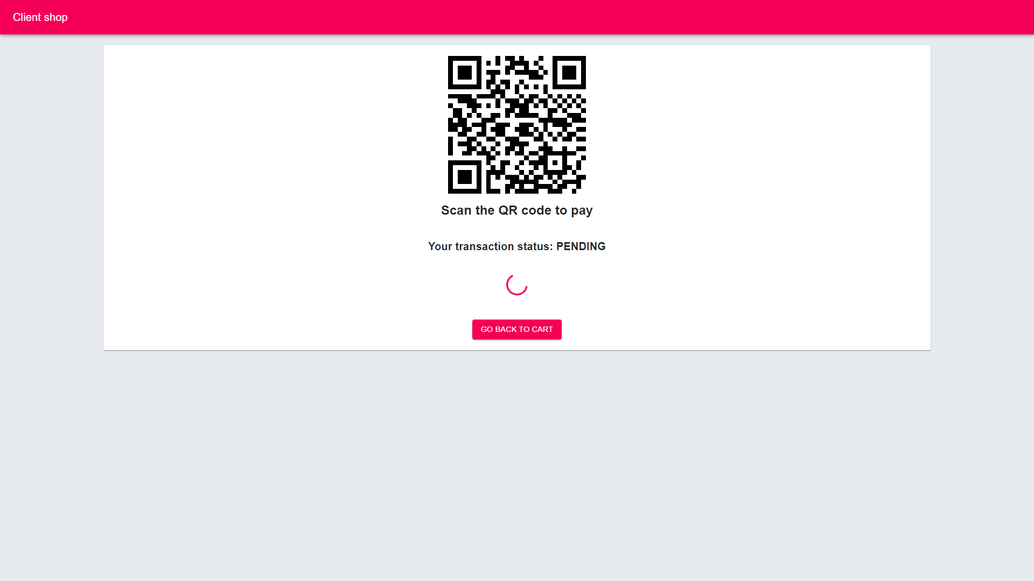
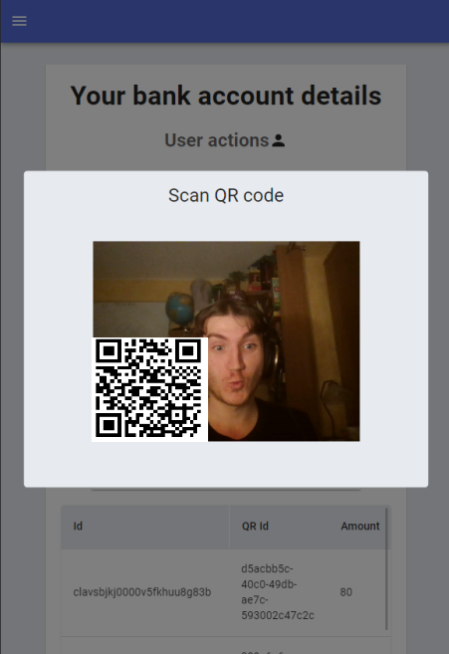
PRESENTATION OF SOFTWARE AND SYSTEM ARCHITECTURE

Slide 11
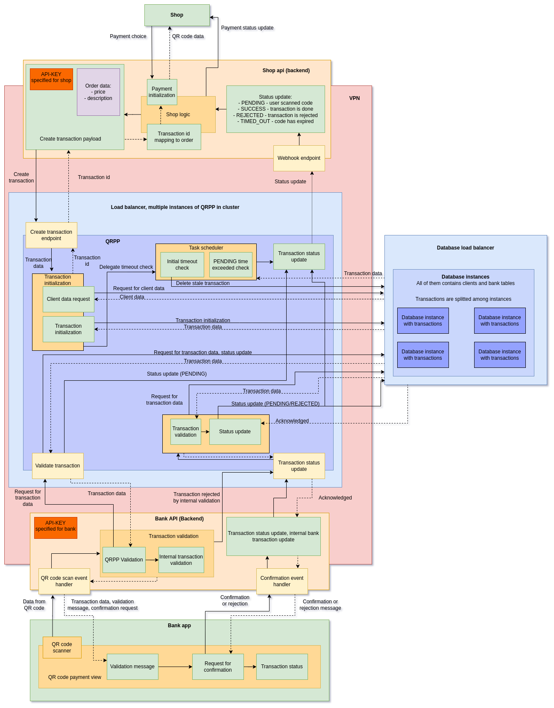
ARCHITECTURE

Slide 12
THANKS!
We are ready for your questions!
Wojciech Pietruszewski
Jakub Sieczczyński
Jakub Chełchowski
Adam Kalista

